Slide 1


Vehicle Service Management System
A Secure Full-Stack Web Application built using ASP.NET Core and Angular
Presented by
Aditya Bahadur
8th Jan 2026

Slide 2
Table Of Contents
Problem Statement
Project Objectives
Functional Objectives
Technology Stack (Backend & Frontend)
Solution & Key Features
System Architecture
User Roles
System Workflow (Flowchart)
Security Features
Quality Assurance and Testing
UI Screenshots

Slide 3
Problem Statement
Current Challenges
Many service centers use manual or partially automated systems
Difficulty in tracking service requests and vehicle history
Poor coordination between staff and technicians
Impact
Long customer wait times
Inefficient technician and parts management
Reduced overall service quality
Need
A centralized system to improve service tracking, scheduling, and operational visibility

Slide 4
Project Objectives
Primary Goal
Create a secure, centralized system that makes vehicle service management smoother and improves the experience for customers.
Technical Objectives
• Build a REST-style API with ASP.NET Core Web API and SQL Server
• Create a flexible, easy‑to‑use interface with Angular and TypeScript
• Add login security with JWT and role‑based permissions
• Use clean structure and strong development methods
Project Duration
Duration: 10 Days

Slide 5
Functional Objectives
Functional Objectives
• Support booking, tracking, and managing service requests
• Help assign technicians and follow their work progress
• Track spare parts and prepare service bills
• Offer clear dashboards and reports for daily insights

Slide 6
Technology Stack
Backend (Server-Side)
Framework: ASP.NET Core Web API (.NET 8)
Database: SQL Server
ORM: Entity Framework Core
Data Handling: LINQ
Security: JWT-based Authentication & Role-Based Access Control (RBAC)
API Documentation: Swagger / OpenAPI
Frontend (Client-Side)
Framework: Angular (Latest Version)
Language: TypeScript
UI Library: Angular Material / Bootstrap
Forms: Template-Driven & Reactive Forms
API Communication: HttpClient & Interceptors
Tools & Testing
API Testing: Postman
Unit Testing: xUnit
Version Control: Git & GitHub

Slide 7


Solution & Key Features
Service Request Management
Technician Assignment & Tracking
Book services and track service status throughout the lifecycle
Assign technicians and monitor service progress in real time
Inventory & Parts Management
Billing & Payments
Track spare parts usage and update inventory automatically
Generate service bills and track payment status

Slide 8
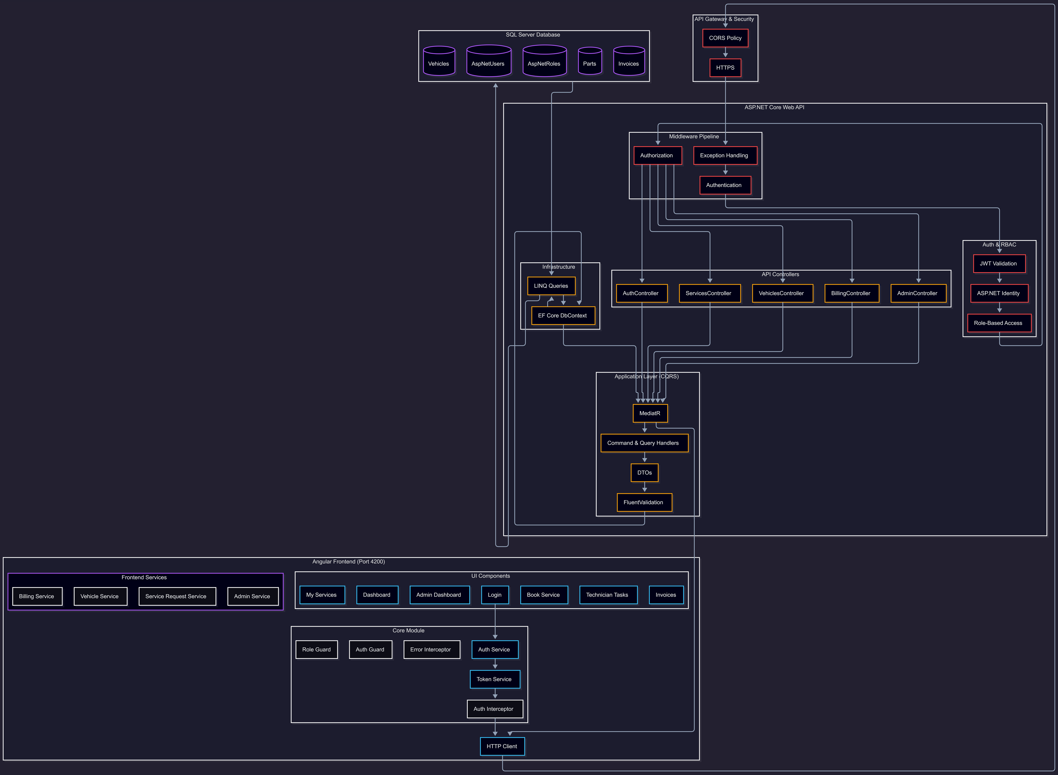
System Architecture

Slide 9
User Roles
Admin
Service Manager
Manage users, service categories, and pricing
View system-level reports and configurations
Assign service requests to technicians
Monitor service progress and workload
Technician
Customer / Vehicle Owner
Update service status and add remarks
Complete assigned service tasks
Book service requests
Track service status and view service history

Slide 10
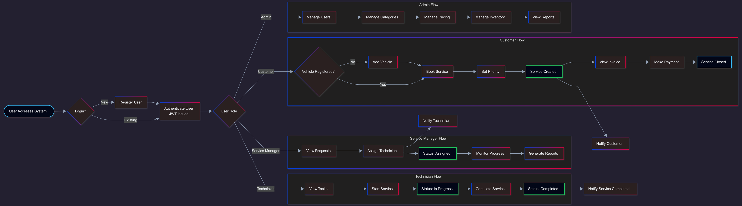
System Workflow (Flowchart)
The system routes users to role-specific workflows after login. Customers book services, Managers assign technicians, Technicians complete work, and Admins manage the system. Services flow through status stages with real-time notifications.

Slide 11
Security Features
Authentication & Authorization
JWT-based authentication for secure user login
Role-Based Access Control (RBAC) for Admin, Manager, Technician, and Customer
API & Data Security
Secured REST APIs using authorization filters
Protected endpoints based on user roles
Validation of user requests before processing
Application Security
Centralized exception handling
Secure handling of customer and vehicle data
Configuration managed using appsettings.json

Slide 12
Quality Assurance and Testing
Testing Approach
Unit testing using xUnit to validate business logic, service components, and calculations
Testing includes bill generation, payment processing, and LINQ-based report logic
API & Integration Testing
REST API testing using Postman
Validation of successful requests, error handling, and edge cases
Security Testing
Authentication and authorization test cases for JWT token generation and validation
Role-based access control verification for different user roles
Ensured secure access and data isolation across the system
Tools Used
xUnit – Unit testing (.NET)
Postman – API and integration testing
Swagger – API documentation and quick verification

Slide 13
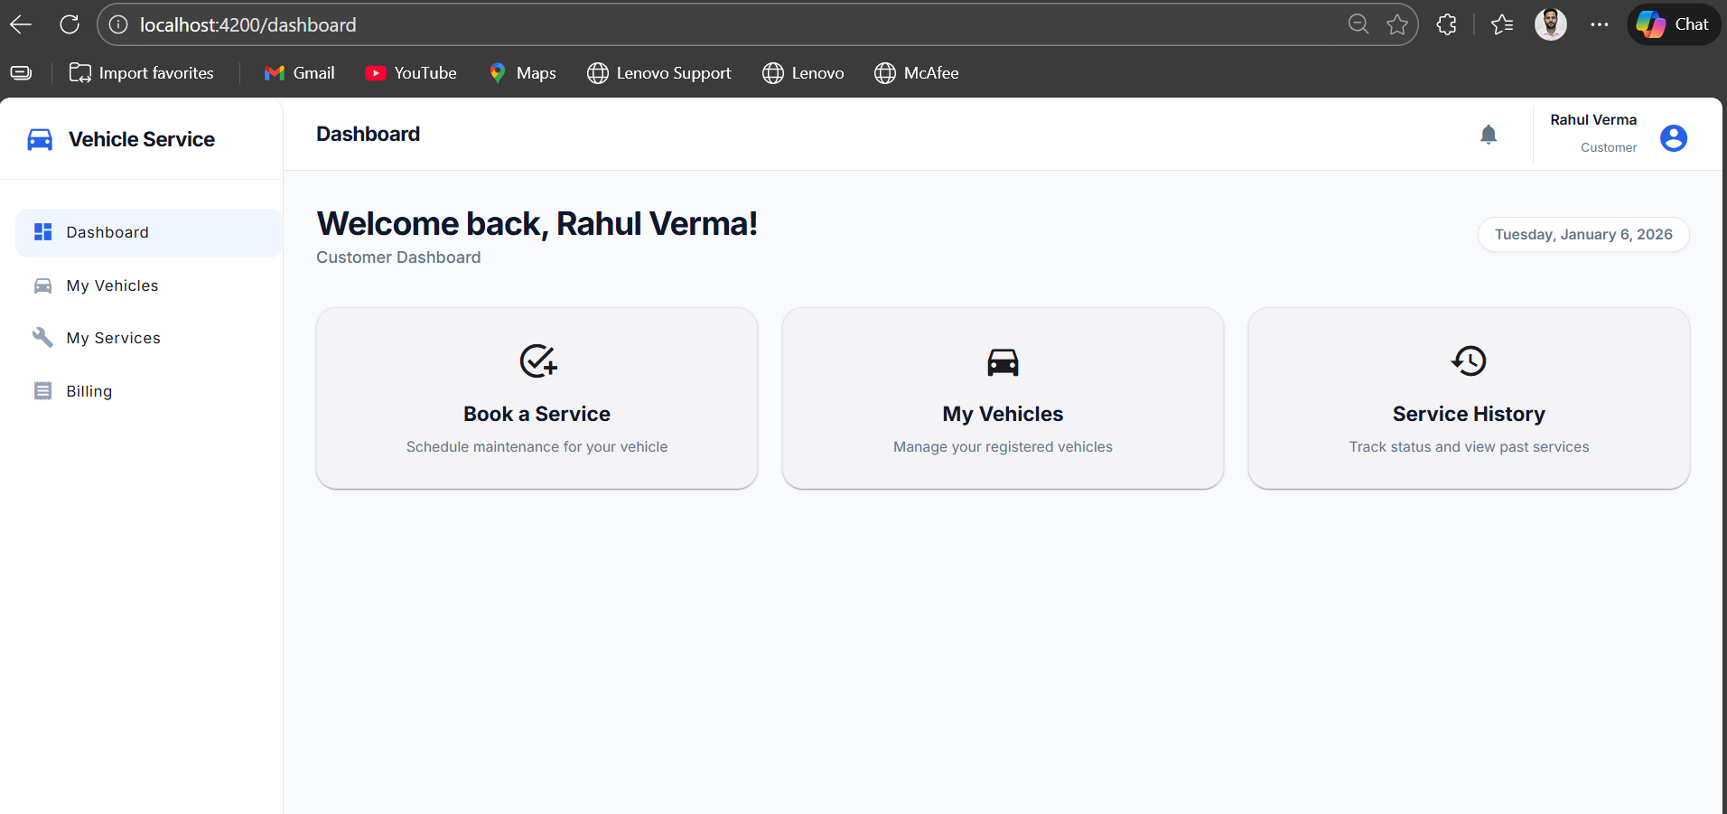
Customer (Vehicle Owner) Dashboard

Slide 14
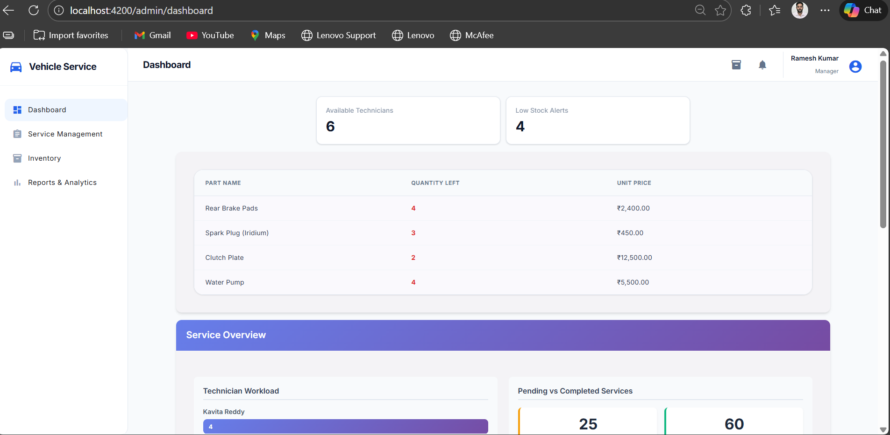
Service Manager Dashboard

Slide 15
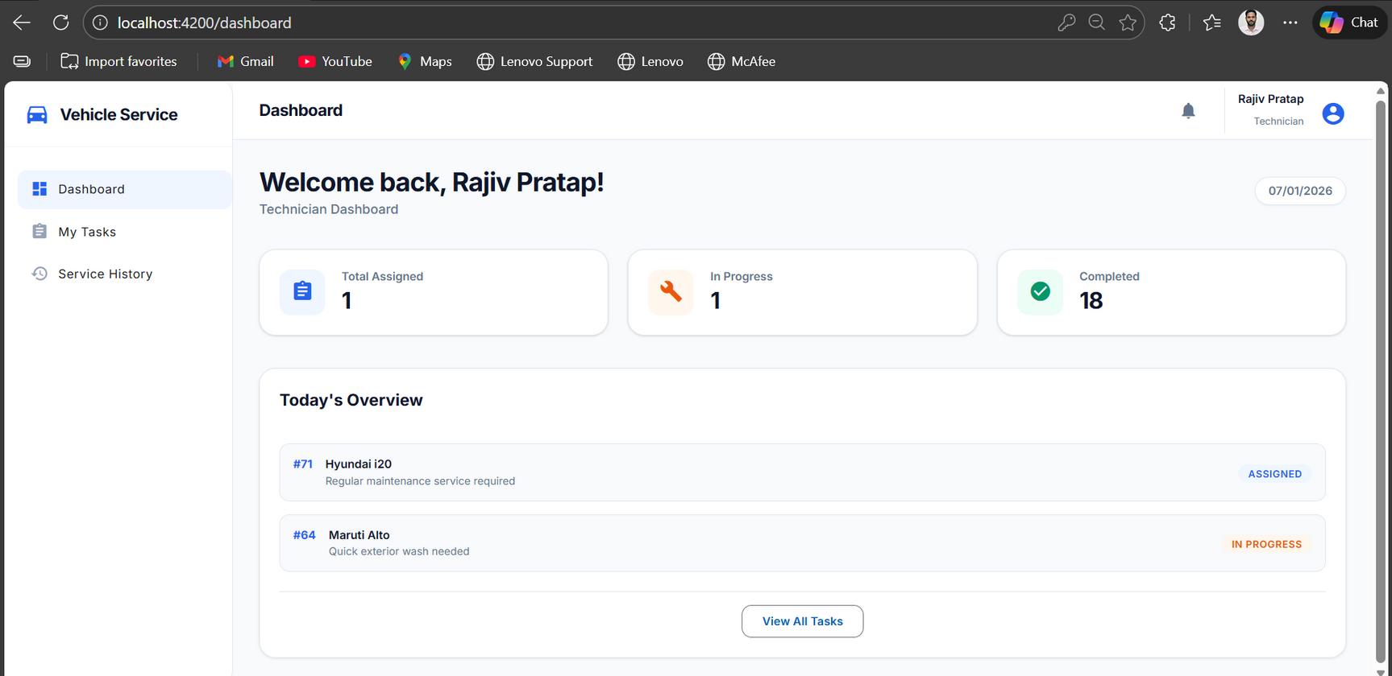
Technician Dashboard

Slide 16
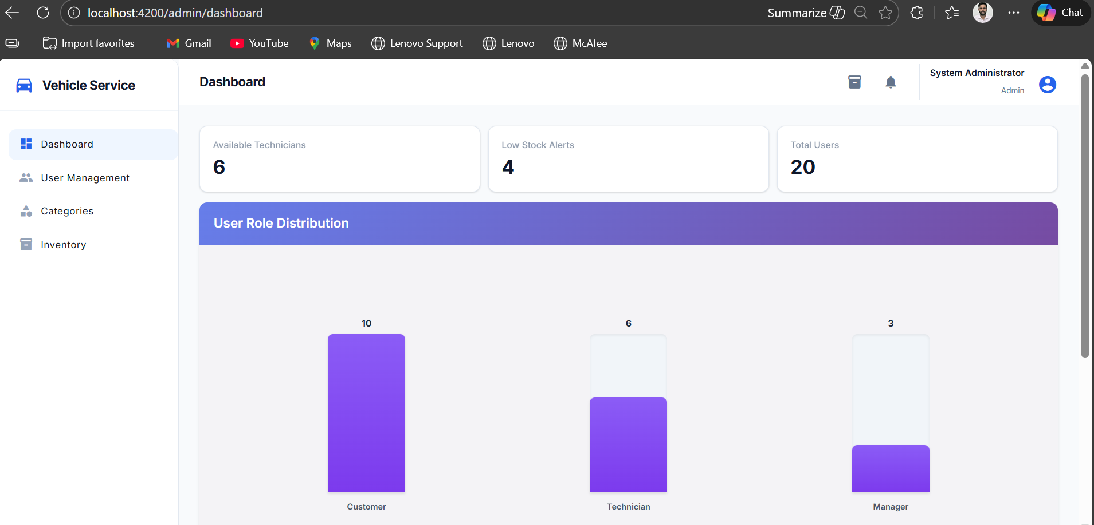
Admin Dashboard

Slide 17
Live Demonstration
A walkthrough of system functionality
Demo Flow: Login → Service Booking → Assignment → Completion → Billing

